Slide 1
REACT

Slide 2
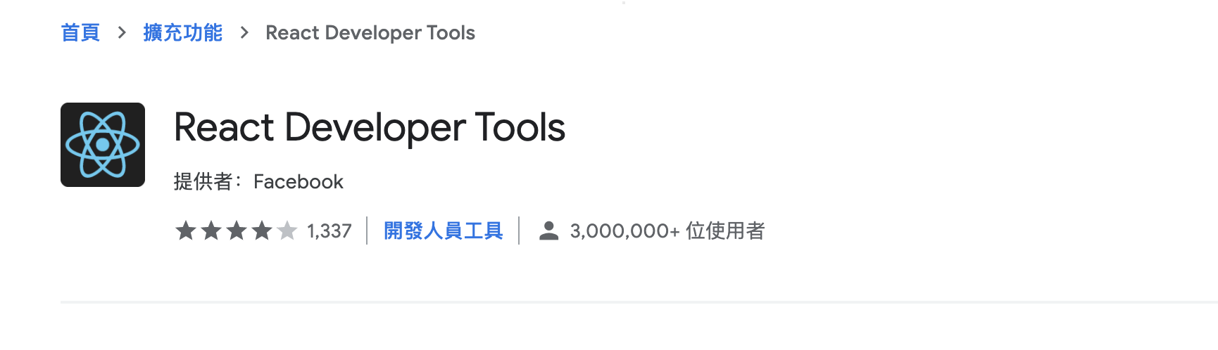
Advantage
Reusable components
hooks
Notes:
可重複利用
改變網頁的部分但不會影響其他功能

Slide 3
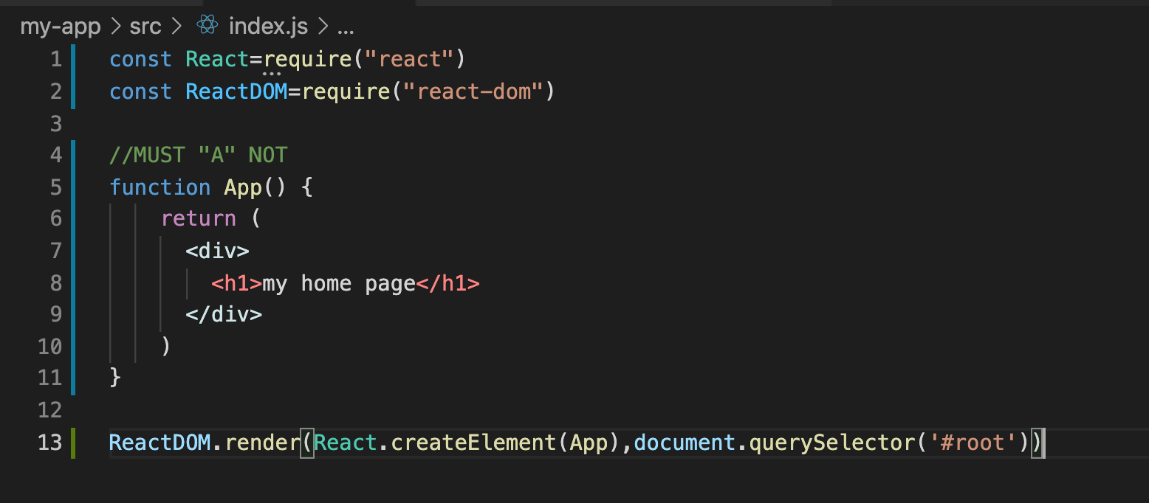
Create
npx create-react-app my-app
Only remain index.js/app.js
Notes:
If in js mode is createelement and create element
A一定要大寫

Slide 4
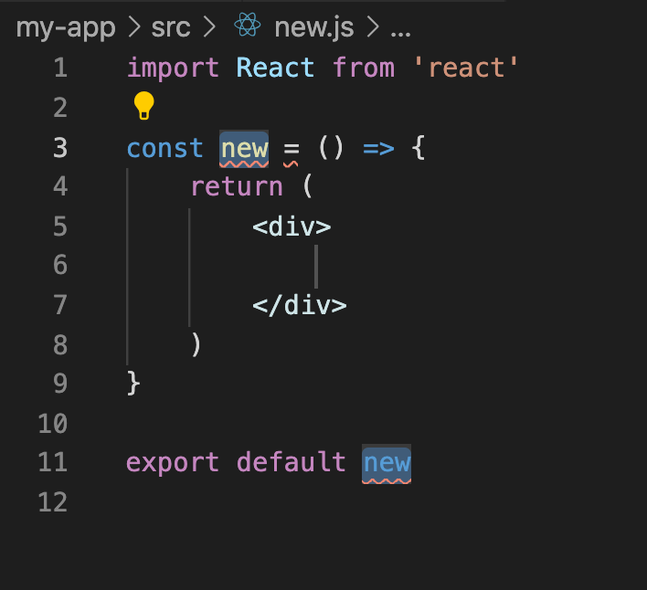
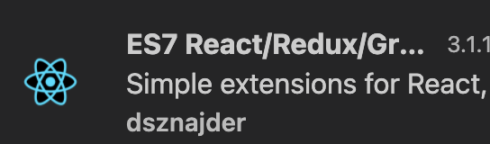
Setting react file
Setting.json
”files.associations”:{
“*.js”:”javascriptreact”
}
VS code extention:
Use rafce to auto create a model

Slide 5
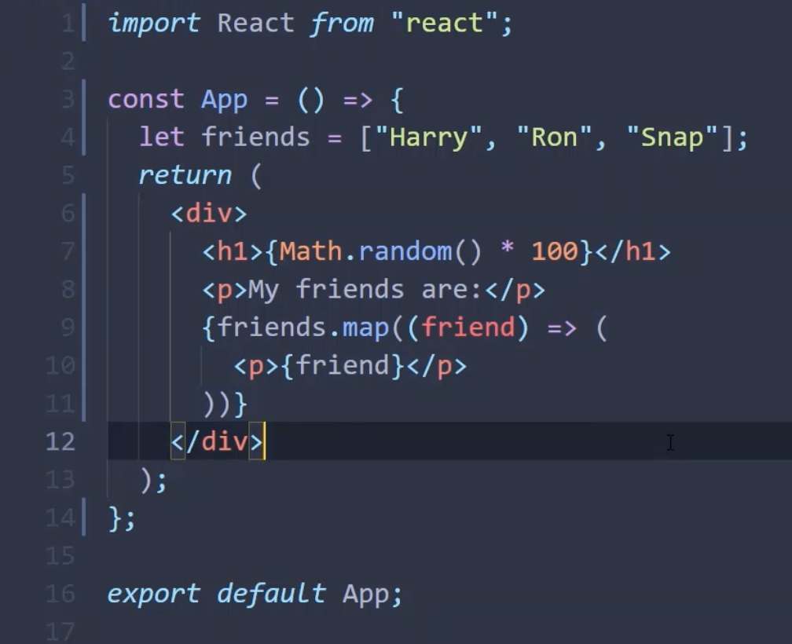
Javascript in jsx
Use {} to write in js
Notes:
Ejs use <% %>

Slide 6
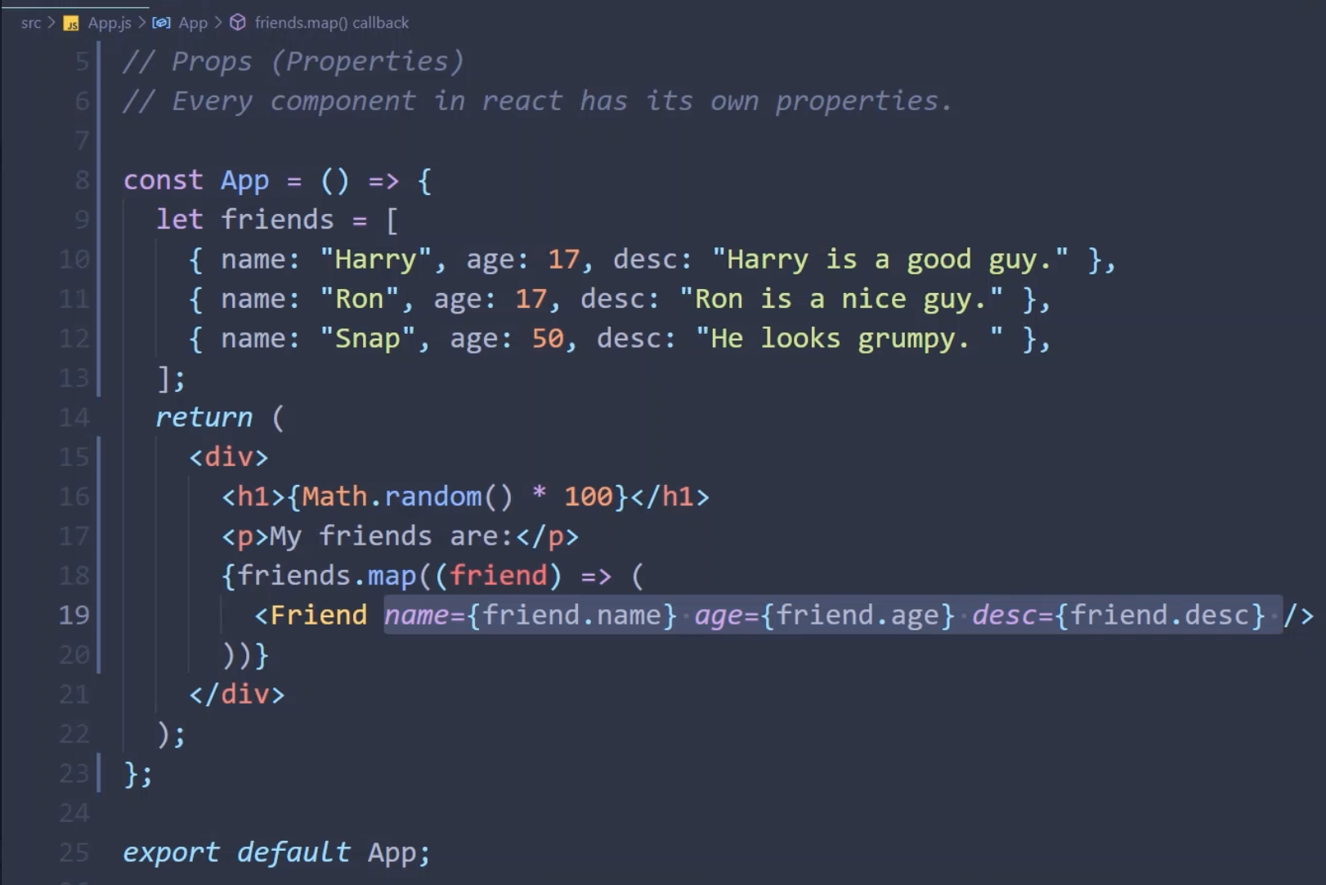
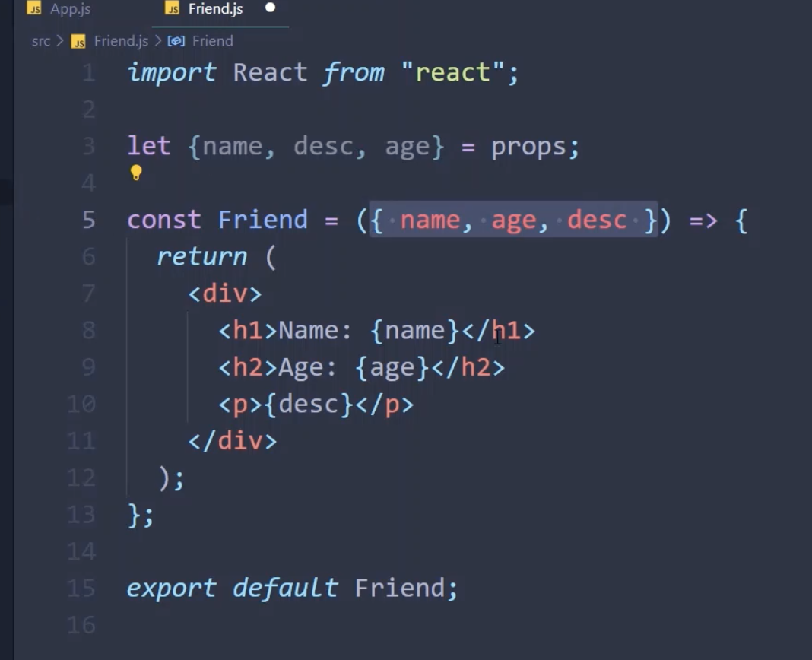
PROPS (Properties)

Slide 7
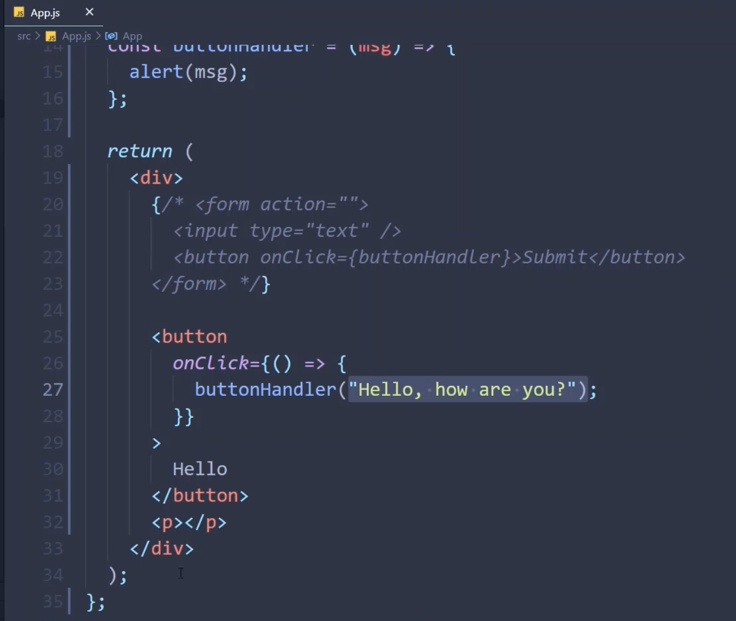
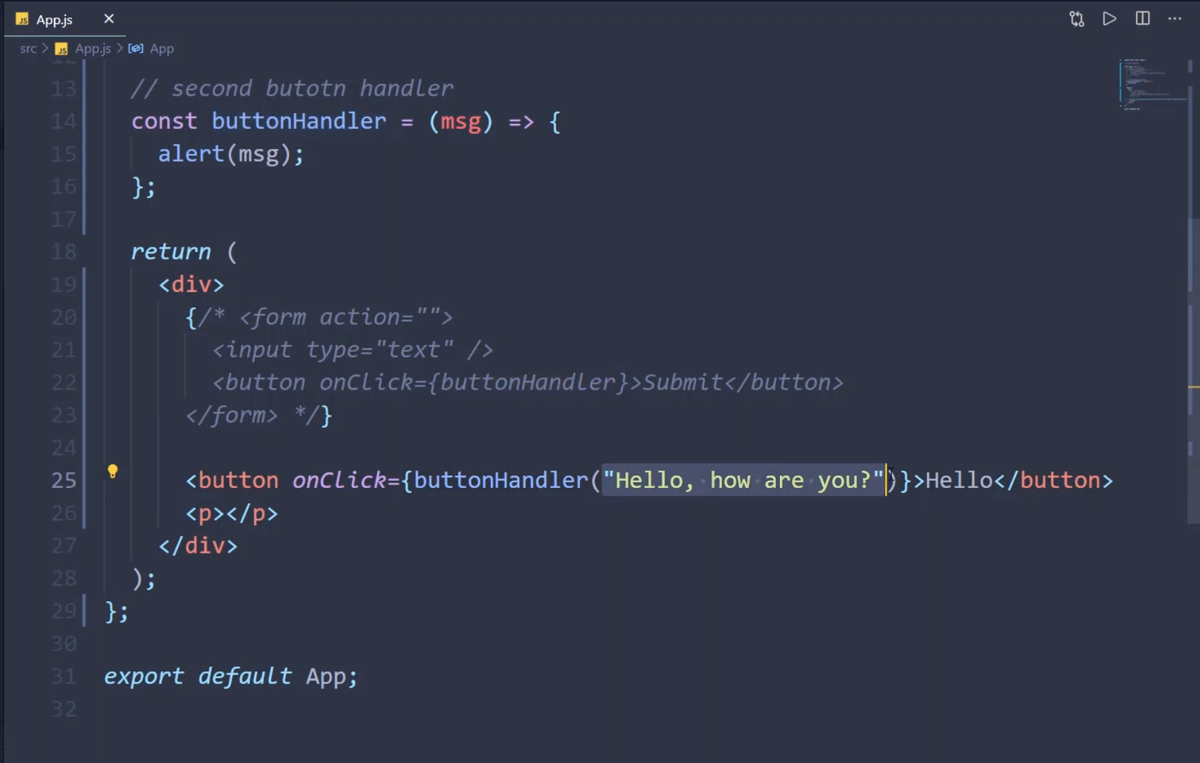
Event handling
Js : .addEventListener()
React:

Slide 8

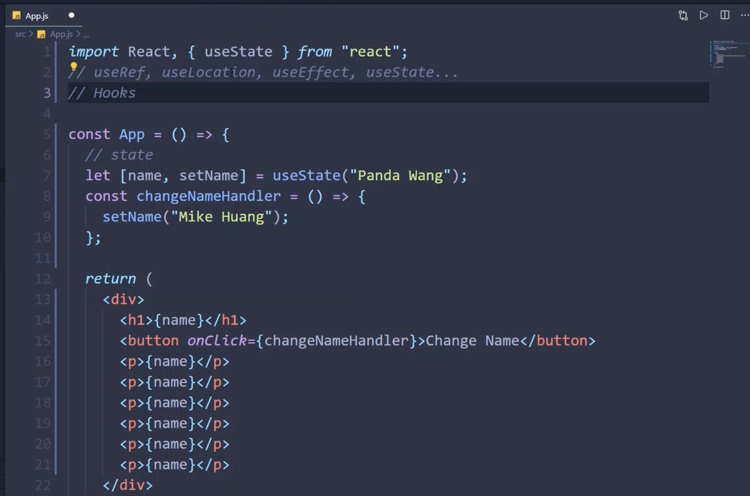
State (Hooks)
Import 要多一個 {useState}
Notes:
1.React 優點就是可以跟sever獨立做互動
2.State 在react share data, 所有跟state 有關都會改變
3. React 會一直自動re-render

Slide 9
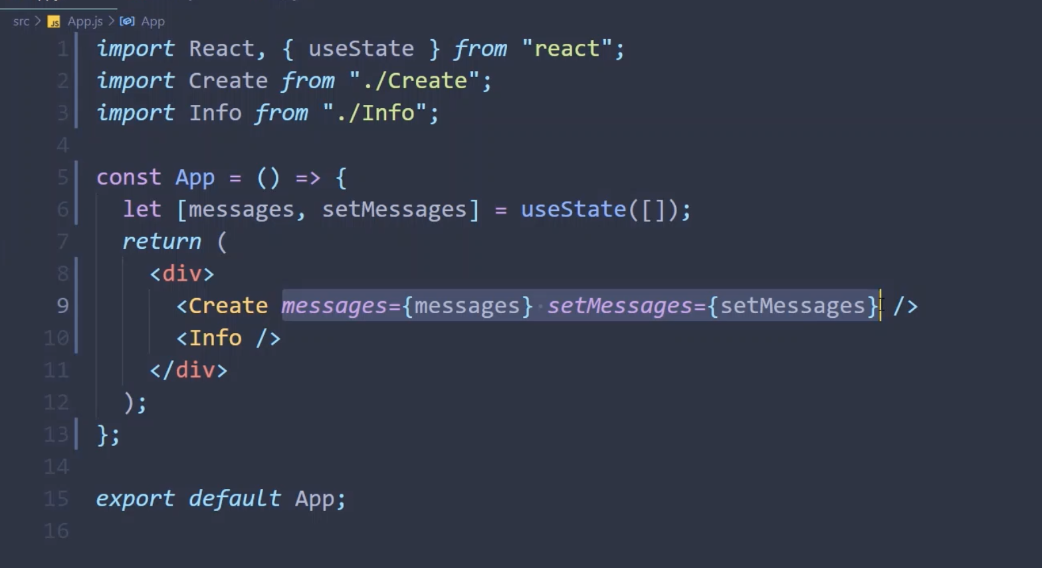
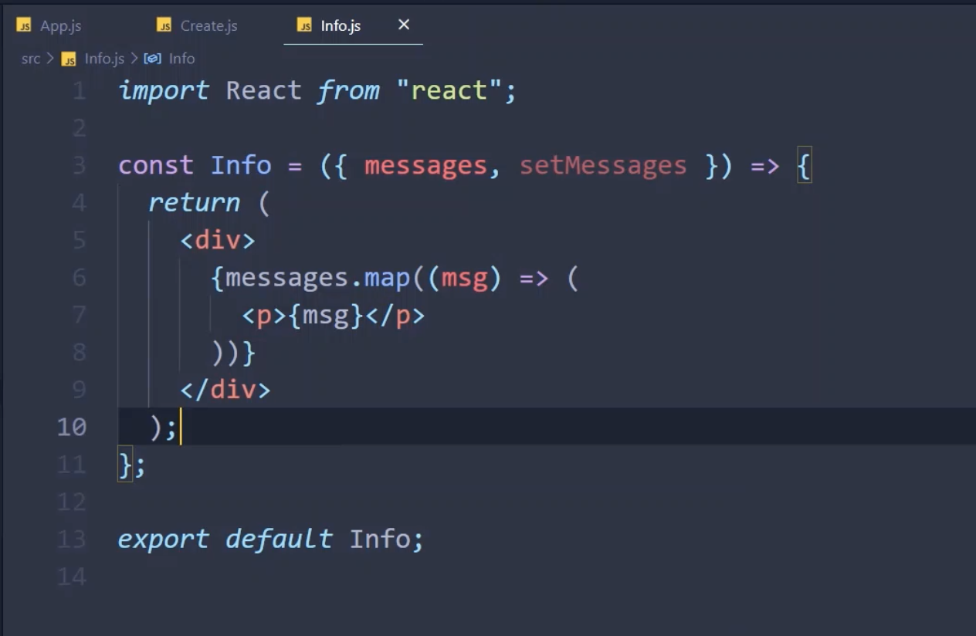
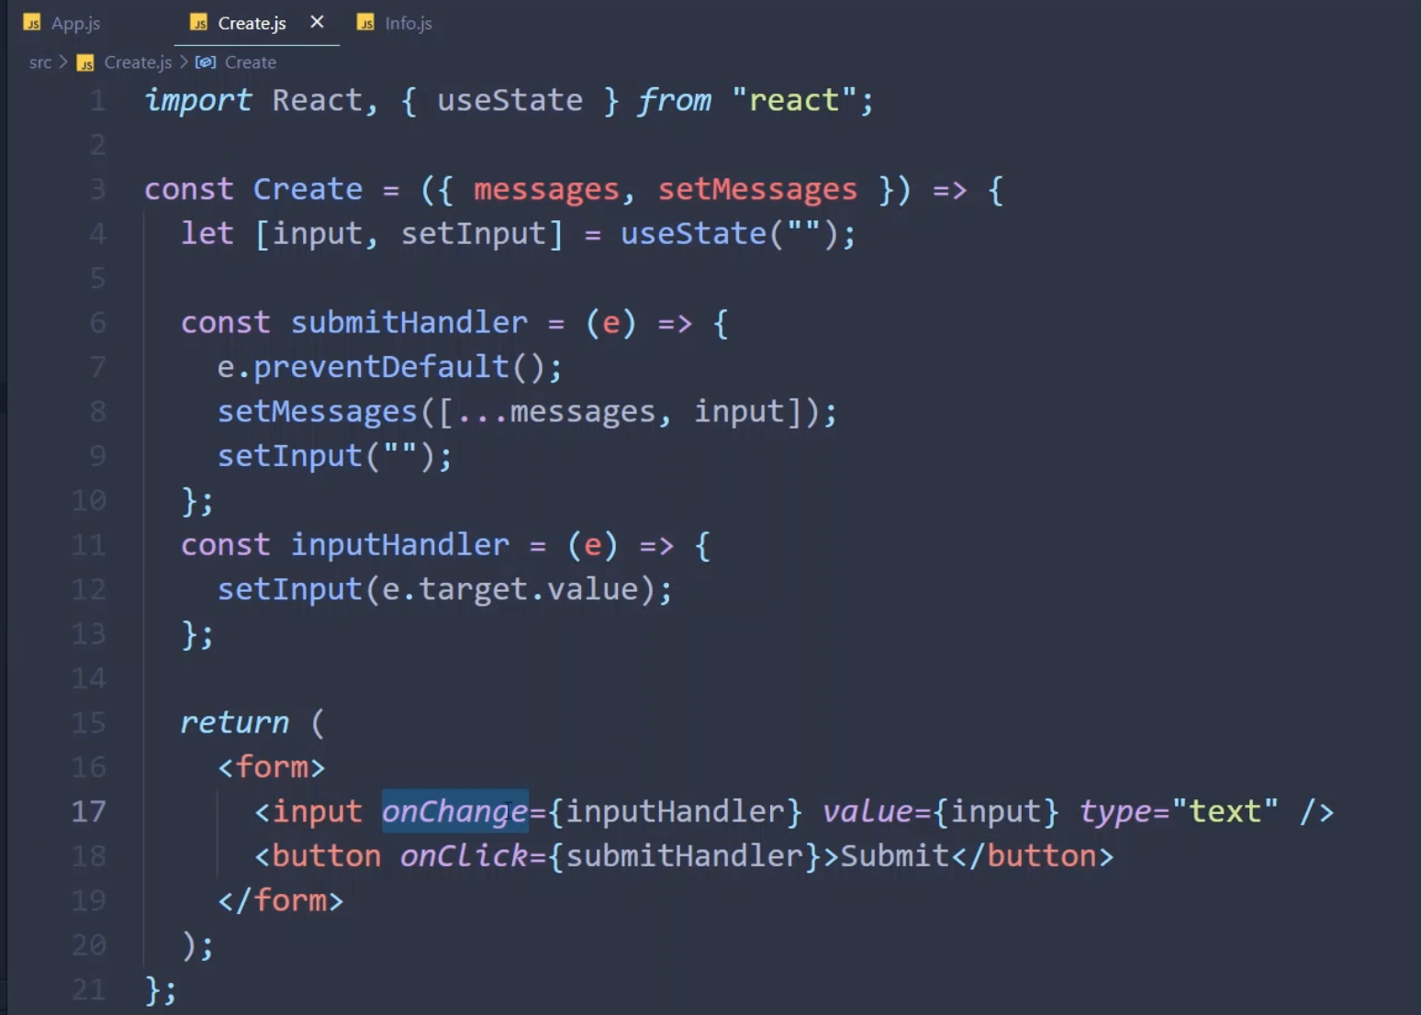
State lifting

